Slide 1
X-section Y-Z
See Cross section locations.kmz & Cross section labels.kmz for location in Google Earth

Slide 2
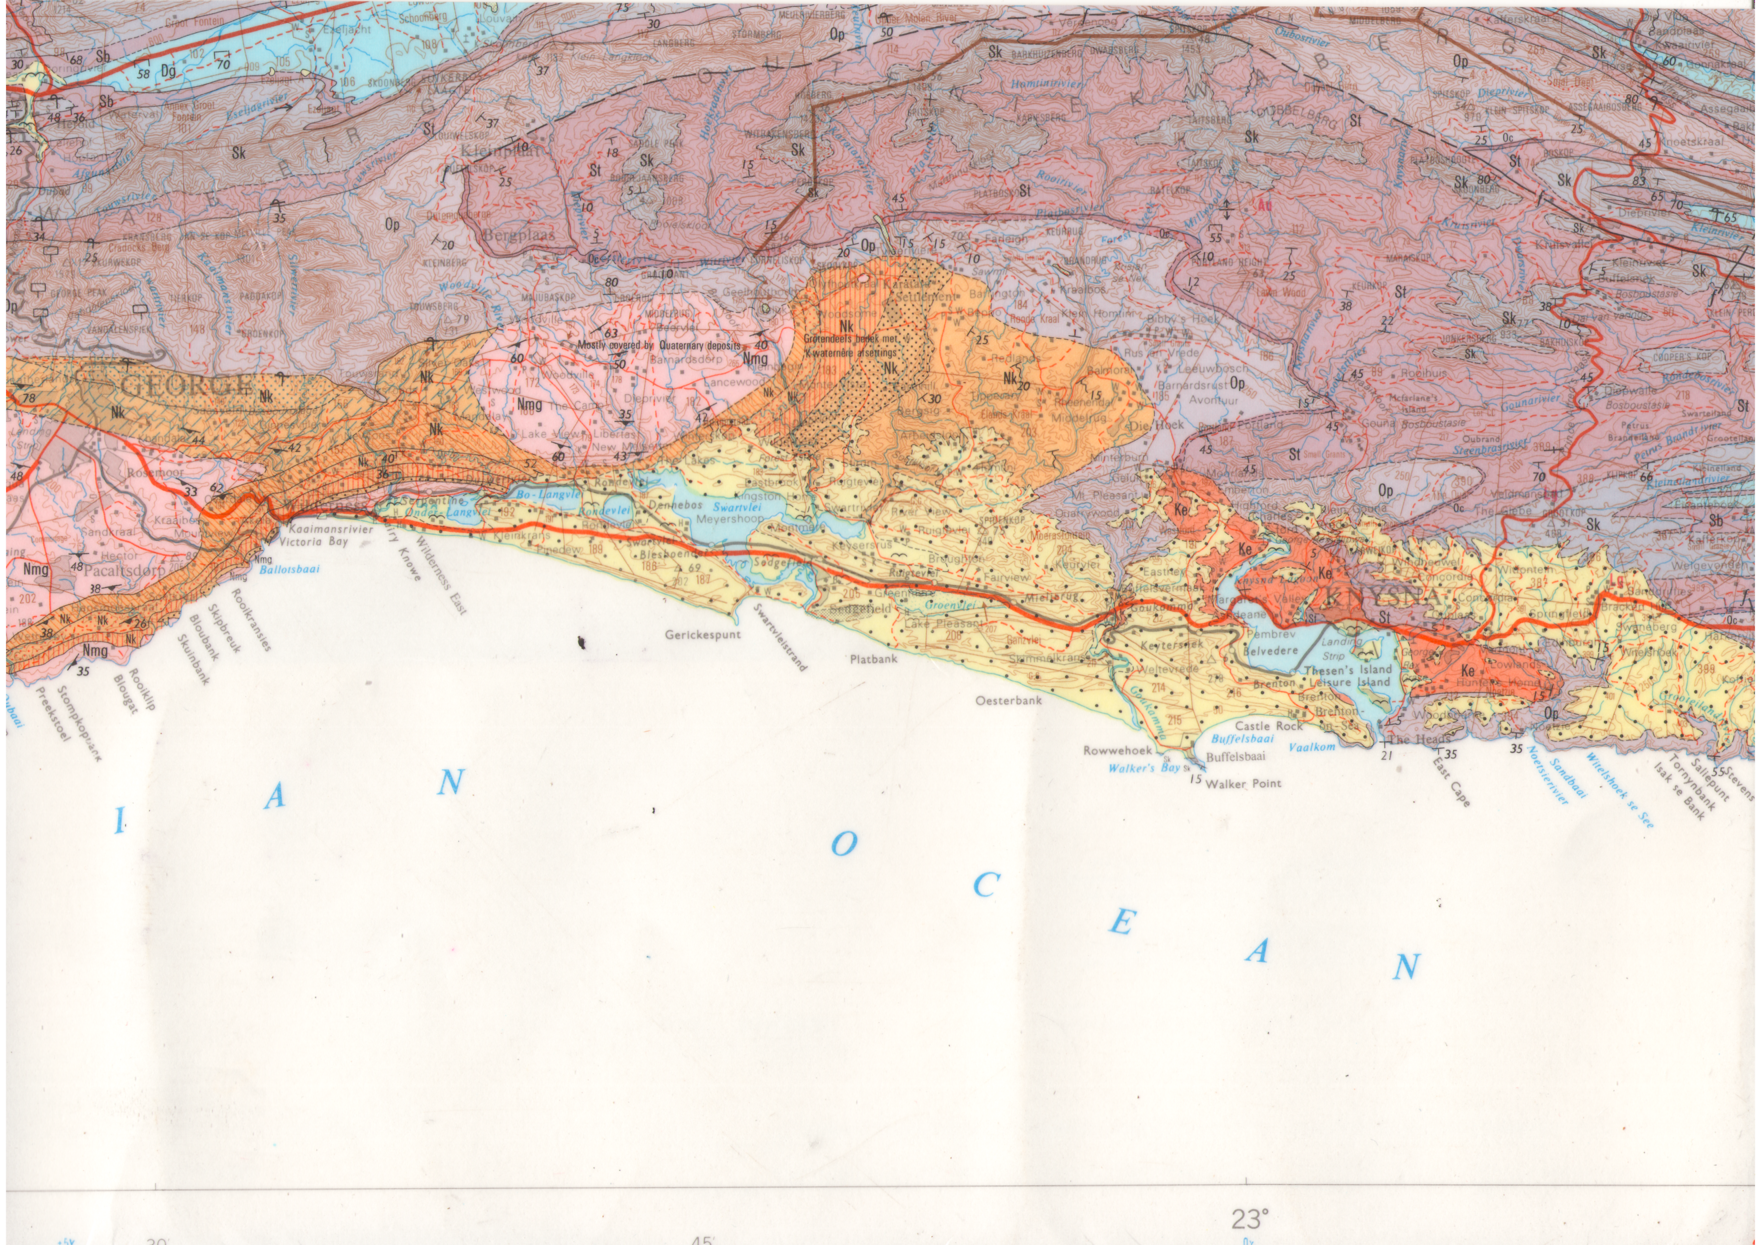
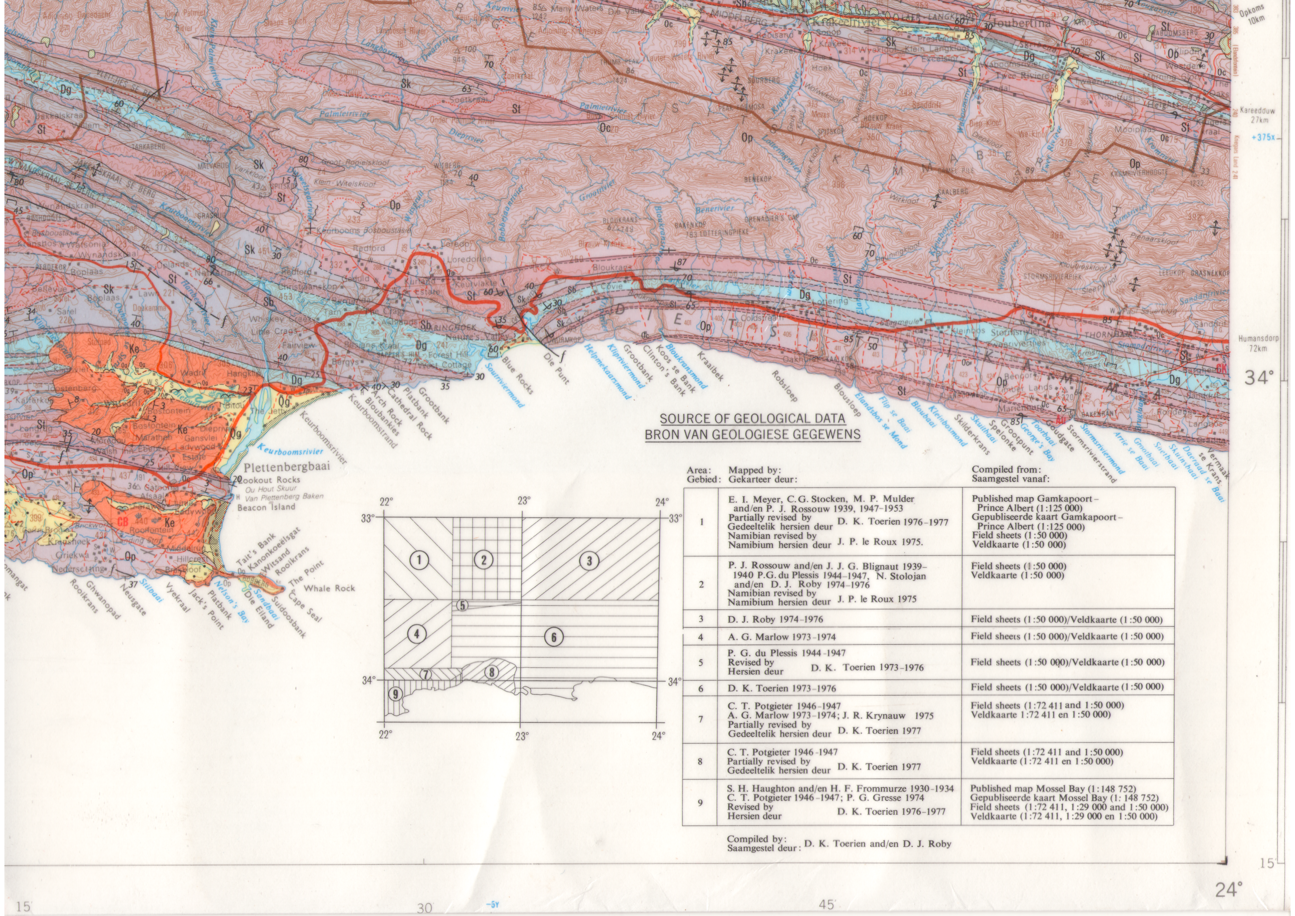
Portion of 1:250 000 Geology Map 3322 Oudtshoorn
Cape Supergroup
Ordovician to Carboniferous
490 Ma to 330 Ma
Z
Robberg Group
Cretaceous
135 Ma to 90 Ma
Dune Rock
Holocene
< 2 Ma
Y

Slide 3
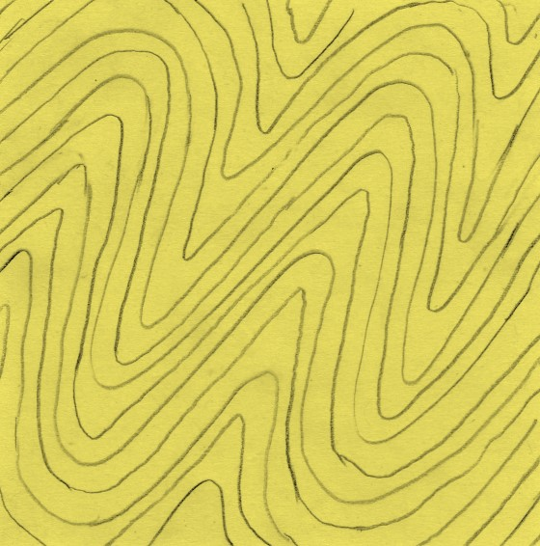
Schematic Geologic Cross-section Y-Z Through Cretaceous Pletmos Basin
Looking northwest - vertical exaggeration x 13
masl
masl
300
f
Robberg Formation LEGEND
300
Plett Airport runway
Tidal to shallow marine sandstones, interbedded estuarine mudstones
f
200
N2
Beach conglomerates, basal talus breccias
200
Piesang River
Plett
Bitou River
Baviaanskloof
100
100
R340
0
Indian Ocean
0
Dgs
Kouga sandstone
Dg
Baviaanskloof
Peninsula sandstone
Kouga sandstone
-100
Tchando sandstone
-100
Peninsula sandstone
Tchando sandstone
Cedarberg shale
-200
-200
Peninsula sandstone
-300
-300
f
Peninsula sandstone
-400
f
-400
Kaaimans schists
f
-500
-500
0
5
10
15
km
Y
Z

